Slide 1

PowerShell Advanced Scripting
Adam Driscoll
Adam Driscoll
Twitter: @adamdriscoll
adriscoll@concurrency.com
Senior Application Developer

Slide 2
Agenda
User Interaction
Advanced Functions
Creating Modules
Extensible Type System
PowerShell Jobs
Lab

Slide 3
User Interaction
UI Basics
Credentials
Confirmation
Progress

Slide 4

Read-Host

Slide 5
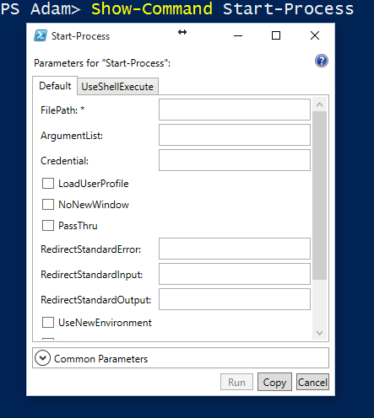
Show-Command

Slide 6
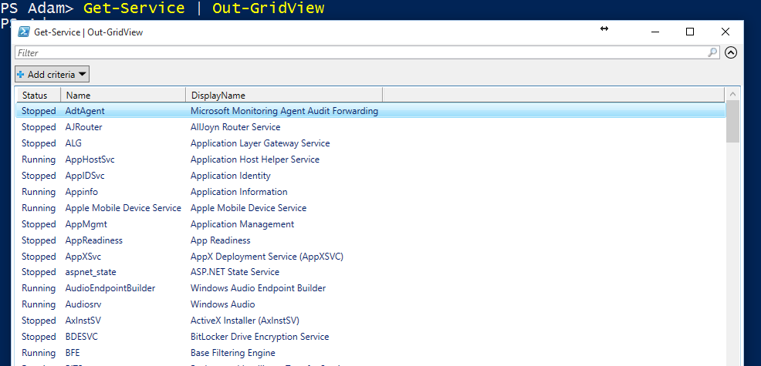
Out-GridView

Slide 7
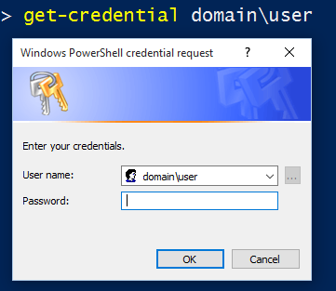
Credentials
Get-Credential to pop up a dialog
PSCredential UserName\Password Pairs
SecureString for Passwords

Slide 8
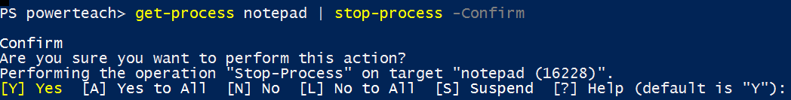
Confirmation
$Global:ConfirmPreference
Confirm
WhatIf

Slide 9
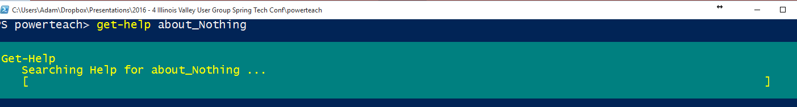
Progress
Write-Progress
Displays status based on the PowerShell host’s implementation
Notes:
Code .\UserInput.ps1 (maybe)

Slide 10
Advanced Functions
Cmdlet Binding
Parameter validation
Accepting Pipeline input
Inline Help

Slide 11
Cmdlet Binding
CmdletBinding Attribute
ParameterAttribute
ValueFromPipeline
ValueFromPropertyName
Parameter Sets

Slide 12
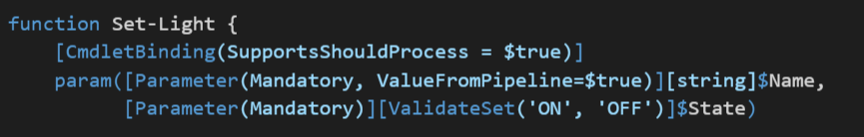
Parameter Validation
Built-in validation attributes
ValidateSet
ValidateRange
Mandatory
Custom Attributes
ValidateScriptBlock

Slide 13
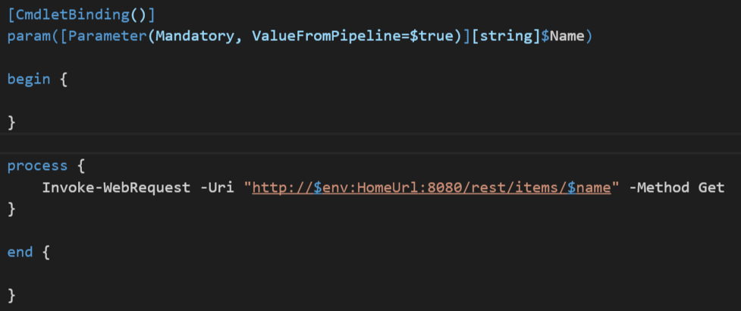
Accepting Pipeline Input
Begin Block – Run once before pipeline input is processed
Process block – Run for every item in the pipeline
End Block – Run once after pipeline input processed

Slide 14
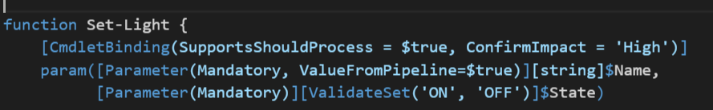

ShouldProcess\ShouldContinue
Support for ConfirmPreference
Support for WhatIf

Slide 15
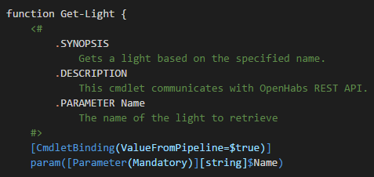
Inline Help
Discoverable by Get-Help
Multi-Line Comment
Notes:
Code .\AdvancedFunctions.ps1

Slide 16
Creating Modules
Copy-deployable sets of functionality
Can include aliases, functions, type formats, etc
Installable via PowerShell Gallery
Easy to make!

Slide 17
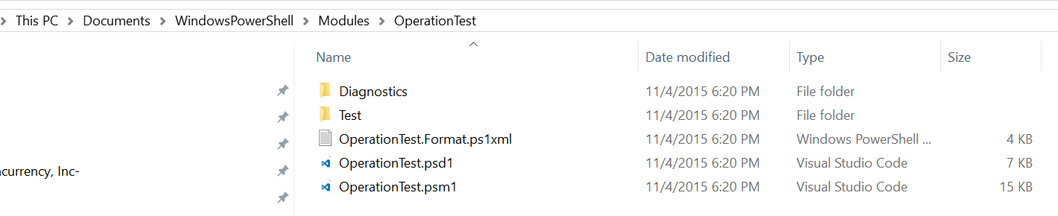
Anatomy of a Module
Module Folder ($Env:PSModulePath)
Type Formatting File
Module Manifest
Root Module
Notes:
Module demo here

Slide 18
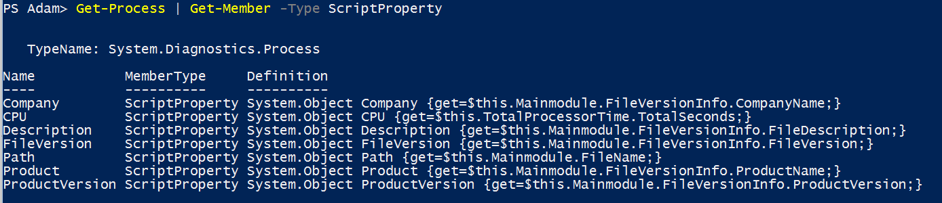
Extensible Type System
Types can be extended to include additional properties and methods
Types can be extended dynamically with Add-Member
Types can be extended via Type PS1XML files
Notes:
.\Start-Demo.ps1 .\ExtensibleTypeSystem.ps1

Slide 19
PowerShell Jobs
Run work asynchronously
Works for remote commands
Can be scheduled
Startup cost to creating jobs
Notes:
.\Start-Demo.ps1 .\Jobs.ps1

Slide 20
Lab
Create an advanced function that searches for executable (EXE and DLL) files on your machine matching a particular pattern and version number.
Accept a directory by pipeline
Implement a AsJob parameter to utilize jobs and avoid blocking during execution
Make sure to validate inputs
Write progress for execution where AsJob is not specified

